Slide 1
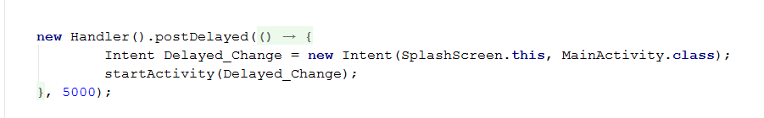
Warm-up
Declare an inner class that implements Runnable
Create a Handler instance
Create an instance of the Runnable
Call the appropriate Handler method, passing in the appropriate argument.
Notes:
Seeing a lot of this.
Just dumped into the onCreate
Not confident this code is really understood.
In the handout, it said to look into the Runnable interface. That’s not even mentioned here.
Without understanding it, you don’t really have mastery of this technique.
For example, would you be able to make something happen before the launch? E.G. play a loading animation?
What other sorts of things can postDelayed accept?
What is the -> for?
How is this syntactically different from other options?
Etc.
This is a compressed format of the general logic…

Slide 2
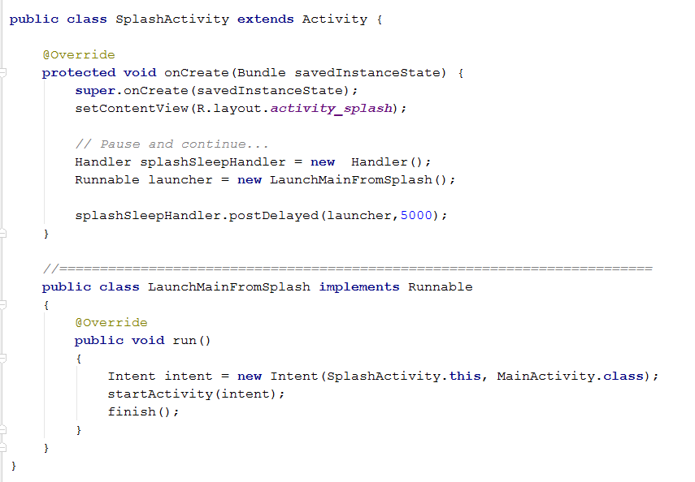
Warm-up
Notes:
The complete structure.
Note finish(). If you didn’t call it you are not thread safe.

Slide 3
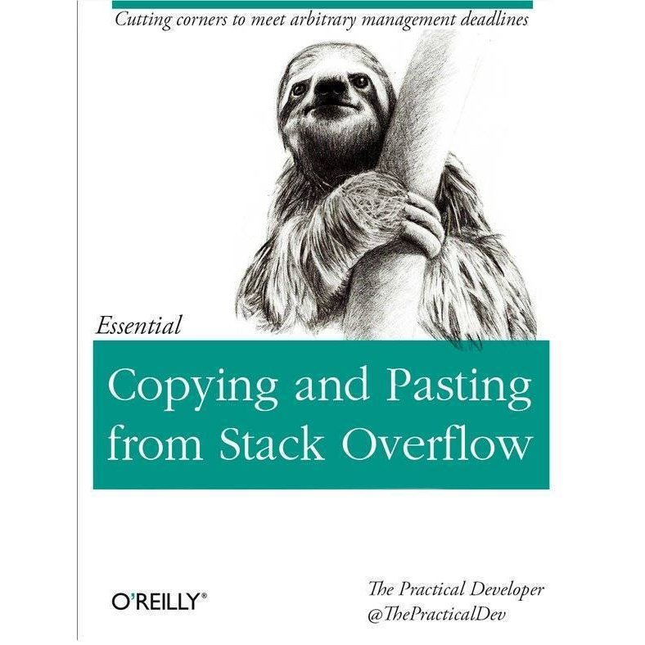
Notes:
We are not here to do this.

Slide 4
Human Computer Interaction
IN721 Design and Development for Mobile
Semester 1, 2017
Session 3.2

Slide 5
Recommended Reading
Donald Norman, The Design of Everyday Things
Chapters 1 and 2
Notes:
Book in library and online
Read it.
If you are planning on designing things for humans, read it.
Not examinable.

Slide 6
Human-Computer Interaction
Humans:
Perceptual characteristics
Cognitive characteristics
Computers:
Screen appearance
Functionality
I/O
Notes:
Humans:
We will look at the capabilities of the human information processing system.
We will consider both the perceptual characteristics (e.g. what colours are easiest to perceive; what sound frequencies are most salient, etc.), and the cognitive aspects (e.g. how many items can a person hold in memory).
We will see that the peculiarities of the HIP system will strongly direct the choices you make in your design.
Computers:
We will consider the options for the computer’s behaviour, including screen appearance, input/output devices, etc.
We will see that the “best” choice depends on what you are trying to implement, and what users you are targeting.

Slide 7
Human-Computer Interaction
We divide the human-computer system into two parts:
The Interaction (behavioural – what the user can do)
The Interface (constructional – how the user does it)
Notes:
These days, these map sort of to UX and UI, but UX is such a mushy concept, you can’t really count on it
The interaction component speaks to what the user’s cognitive experience is: what sorts of decisions does she make, what sorts of actions can she perform, what kinds of feedback does she receive, and so on.
The interface component is the implementation of the interaction.
For example, if you are developing a painting program, you will want to allow the user to select a paint tool. “Select a paint tool” is an interaction.
You may choose to instantiate this action via a drop-down menu, a list of radio buttons or an icon palette. This is the interface.
Of the two, the interaction is harder to do well.

Slide 8
The Goals of Interface Design
To empower the user
Notes:
Actually just the one...To empower the user.
We are not interested in technology for technology’s sake.
We are not interested in being on the cutting edge.
We are not interested in using every colour in the 32-bit palette.

Slide 9
The Goal of Interface Design
We are interested in:
Identifying the tasks the user of our software wants to accomplish.
Facilitating that accomplishment.
Avoiding errors, frustration, and unpleasantness of any kind.
Notes:
We are interested in:
Identifying the tasks the user of our software wants to accomplish.
Facilitating maximally that accomplishment, making it as easy, as efficient and as enjoyable as possible.
Avoiding errors, frustration, and unpleasantness of any kind. The question to be asking yourself is: “If your computer were a person, how long until you punched it in the nose?” (Carey, 1989)

Slide 10
Universal Principles
Visibility
Conceptual Models
Feedback
Notes:
Human-computer interface is an absolutely baby science. In fact, HCI was only added to the ACM’s official curriculum about 10 years ago.
However, the general activity of device design has been going on for centuries. We can learn a lot from looking at how successful physical design is accomplished in non-computer disciplines.
We will see that there are certain very basic principles of device design which, when followed, reduce errors, and increase efficiency and enjoyment.
Note: These principles speak to the Interface part, not the Interaction part of the dichotomy described above.
Note also, there is sometimes some overlap in the principles. A violation of one may result in, or result from, the violation of another.

Slide 11
Universal Principles 1
Visibility
The controls of a device must convey the correct message as to how to use them, and what the result will be.
Notes:
First and foremost, visibility
Note that visiblity here refers both to “can be seen” and “can tell how they work”

Slide 12
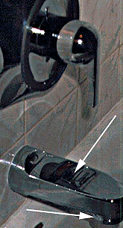
Visibility
Notes:
To turn the shower on here (i.e. to make the water come out of the shower tap rather than the bath tap) you grab the ring under the bath tap and pull it down. This is a control that is completely invisible in the common sense (i.e., you can’t see it)

Slide 13
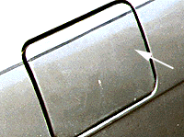
Visibility
Notes:
To open this gas cap, you push on one side and it swings open.
No control is visible. The device can be seen, but you can’t tell how to make it go
It would be better to have a little textured area for pushing, or perhaps a lip on the other side for pulling. Or even a little sticker that says “Push Here”.

Slide 14
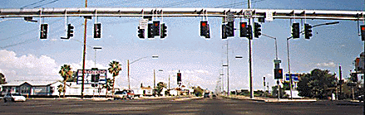
Visibility
Notes:
This is a real intersection in the South Western U.S. Those lights are certainly visible, but which one is yours?
Again, they don’t convey clearly how to use them.
Note again the two senses of “visibility” as used in HCI. Not just “can be seen” but also “function and operation are clear on inspection”.
Think about software you have had trouble using. Were some of the controls not visible (i.e. you couldn’t find them at all – perhaps they were hidden in a menu somewhere), or not clearly conveying the message they were meant to?

Slide 15


Visibility
Notes:
This is the PaintShop Pro tool bar on the left, and Paint.net on the right. Is it clear (visible) what each of these tools does? (Imagine you had never seen a paint program before...)
Look at the crop symbol on the left. The thing that looks like a cold pill on the right (which is really the eraser).
This is a problem we will see repeatedly with icons.
Why use the symbol instead of labelling it as “crop tool”
Universality
Space savings
It looks kewl
Which of these are good reasons, and which are bad?

Slide 16
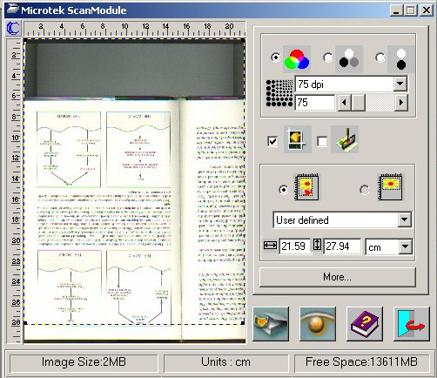
Visibility
Notes:
This is the scan module control from PhotoShop (a couple of versions ago, when printers didn’t scan by themselves...)
It illustrates both good and bad visibility.
The colour/grayscale/bw controls are obvious.
But who can possibly figure out the scan and preview buttons (first and second on the bottom row)? Why get all cutesy with images? Why not just write “Preview” and “Scan” on them? (Older versions of PhotoShop did this, in fact, and were easy to use.
Visibility is such a powerful property that you can use violations of it to intentionally make things difficult. For example, the gate latch at a local daycare centre. First they hide the latch beneath a secret panel, then to work it you have to simultaneously push something in and pull something out, none of which is intuitively reasonable. The purpose, of course, is to prevent the latch from being opened by the children, or by inadvertence.

Slide 17
Universal Principles 2
Conceptual Models
Affordances
Constraints
Mappings
Notes:
The next three universal principles all relate to the notion of conceptual models.
Whenever a person encounters a device, he forms a theory about what it’s for and how it works. These are called “Conceptual Models”.
Failures, errors and difficulties arise when the conceptual model the user builds is not accurate. That is, the device doesn’t work the way he expects it to.
In contrast, when the conceptual model the user builds is an accurate reflection of how the device works, he will be able to predict correctly the effects of his actions. He can use the device successfully without training, experimentaion, etc.
There are three things about any device that determine what conceptual model of that device the user builds. They are affordances, constraints and mappings.
Together, they determine whether a user develops a good, useful conceptual model, or a bad, obstructive conceptual model.

Slide 18
Affordances
Affordances
Properties or characteristics of a device that indicate “what it is for”.
Notes:
Every device tells us, by its appearance, what it is for.
These are its “affordances”.
For example, we see a chair. It is a sturdy, stationary object with a flat surface. We recognise that it is “for” sitting. We say the chair “affords” the act of sitting.
When walking through the dark stacks of the Science Library, you used to see strings hanging from the ceiling. Hanging strings are for pulling. They “afford” the act of pulling. We know we should pull them. We suspect, in fact, that if we pull them the lights will come on. As they do.
Outside the New World is a metal box with holes in it. Round holes afford putting round things in. This metal thing is for smokers to extinguish their cigarettes in.

Slide 19
Affordances
Sensible designs are those where the affordances of the device are both obvious and appropriate.
Notes:
In these cases, what the object affords is clear on inspection and is an accurate reflection of its function, so we know what to do.
However, problems arise when the perceived affordances of a device do not actually match its function.
Let’s look at some examples...

Slide 20
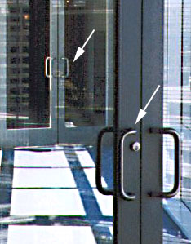
Affordances
Notes:
When you approach these doors, you see the big handles that afford grabbing and pulling.
At the first door, you pull, and the doors open. The affordance is appropriate to the function, and you can use the device successfully.
When you get to the second door however, you grab the big handles and pull, and the doors don’t open. You assume they’re locked and become confused.
In fact, the second set of doors are push doors.
They need a control that affords pushing, like a push plate.

Slide 21
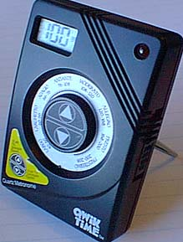
Affordances
Notes:
Round things afford turning. That’s what we do with round things.
The round thing in the center of this metronome clearly affords turning.
It looks like a dial, and we know that we turn dials to make them work.
Unfortunately, to change the tempo, you actually press the up triangle, and the outer ring turns until the correct tempo appears at the top.
Good luck.
See how your conceptual model differs from the actual use of the device.
This is not because you made your conceptual model badly, this is because the design of the device promotes construction of a bad conceptual model.

Slide 22
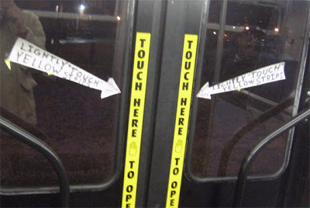
Affordances
Notes:
http://tcsidewalks.blogspot.co.nz/2009/06/signs-of-times-14.html
Instructions on the doors of a bus
Rule: If you need a sign or label giving instructions on how to use a control, the affordance of that control is bad.

Slide 23
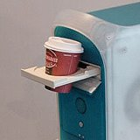
Affordances
Notes:
http://natpryce.com/articles/000805.html
Bad affordances lead to misuse
These examples have all been of physical devices, but bad affordance occurs in software as well.
When users can’t tell if a control is clickable or draggable, for example.

Slide 24
Constraints
Constraints
Properties of a device that make certain actions impossible.
Sensible designs constrain user behaviour so as to prevent errors.
Notes:
Every object has constraints or limitations, properties of its structure that make some actions impossible.
For example, post boxes have smallish spaces for putting in letters. You cannot mail a really large package by stuffing it in a post box, you have to take it to the post office.
Some constraints occur naturally because of physical limitations of the device (for example, the maximum number of people that you may safely put into an elevator).
Other constraints can be designed in for the express purpose of reducing errors or difficulties when working with a device.
Think about door locks, for example. The key must be inserted vertically, so the slot for the key should be vertical. Compare this to padlocks, where you have to spin the slot around to orient it correctly.
Even vertical locks aren’t perfect though. The key to my file cabinet will go in in either of its vertical orientation, but it will only work in one of them. I frequently insert the key, find it won’t turn, swear, take it out, turn it over and try again.
Note that modern car keys get around this by being symmetrical – working either way.
In computers our actions are often constrained to prevent errors.
Example?
An example is the disabling of inappropriate menu commands in most modern menu-driven applications.

Slide 25
Mappings
Mappings
The relationship between actions (performed by the user on the device) and results.
Sensible designs have mappings based on obvious logical, structural or mnemonic relationships.
Notes:
Our interactions with devices are generally indirect. That is, we perform an action on some control (like a light switch), and there is some consequent result on some other part of the device (the light turns on).
Humans learn to understand these relationships (between action and result), by constructing “mappings”, stimulus/response or action/result chains.
These mappings are required for the user to learn what effects his actions will have.
If mappings are difficult to learn, it will be difficult to learn to use the device.
A well-designed device has sensible mappings based on obvious logical, structural or mnemonic relationships.
These are called “natural mappings”.
A poorly designed device is one whose mappings disregard, or worse, violate, the natural mappings.
For example, in my foyer, there is a light switch thingy with two switches. One of these turns on the outside light, the other turns on the inside light. Even though I’ve been using these switches for 20 years, I still can never remember which is which.
The problem is that the switches are stacked vertically, and there’s no particular logic that allows me to map inside/outside to top/bottom.
However, as I face the light switch, the outside light it on my left, and the inside light is on my right. How much more sensible it would have been to stack the switches horizontally so that their spatial position mapped directly to the position of the lights. I would never have gotten this wrong.

Slide 26
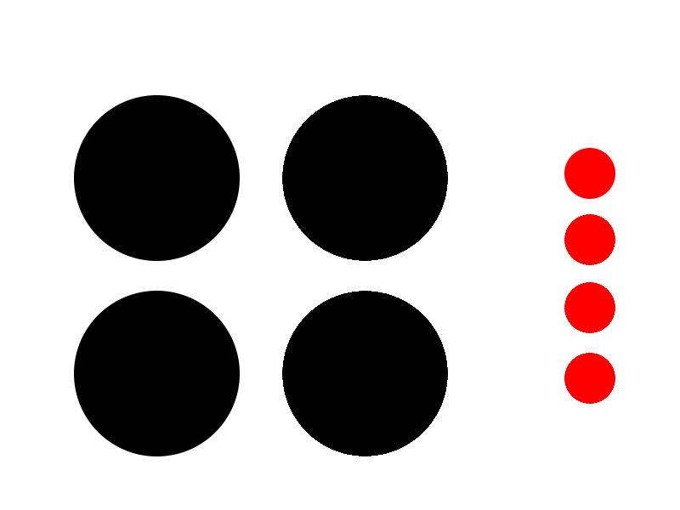
Mappings
Notes:
Another example of this is my stove:
The black circles are the burners, the red are the switches. Who goes to whom?
(A: From the top switch it’s UL, LL, UR, LR)
Wouldn’t it be better if the four switches were in a square like the four burners?

Slide 27
Mappings
Spatial
Logical
Cultural
Notes:
These are examples of spatial mappings.
There are also logical mappings:
For example, to increase the volume on my TV, you push a button on the remote that has an up arrow.
Although volume is not inherently directional, the notion of “up” maps logically to “louder”. Think how confusing it would be if you raised the volume by pushing the down arrow. Nobody would get it.
Mappings can also be cultural.
For example, years of looking at traffic lights have taught us that Red means Stop and Green means Go.
We can use this mapping now in device interfaces, and people will easily map from the color of a control to its function.
In a society without traffic lights, there would be no particular motivation for this mapping (barring the differential perceptibility of the two colours, which is only a minor influence).
A very common example of natural mapping with computers is the next-page and previous-page buttons on web pages.
The previous page is always to the left, the next page is always to the right.
It seems obvious that it should be this way, yet on a web site there is no sense in which the previous page is “to the left of” the current page, or the next page is “to the right”.
We are strongly trained in this left/right mapping because of the way we turn pages when we read a book, and we map naturally from prev/next to left/right based on that experience.
Does this mean that we should reverse the buttons if we are designing for right-to-left reading cultures?
The scan/preview buttons from PhotoShop’s scan module, in addition to being just too precious for words, are mapped wrong. One previews first, then scans, so the Preview button should be first (i.e. on the left).
Mappings are extremely powerful, and once learned, extremely difficult to overcome.
For example, my husband had been driving in New Zealand for a year before he stopped indicating his intention to turn by starting up the windshield wipers. He had learned that the turn signals are on the left (as they are on left-drive cars) and his brain was unwilling to consider otherwise.
Try never to violate natural mappings.

Slide 28
Mappings
Metaphor:
When a design is modelled on a pre-existing knowledge domain.
Notes:
A special case of mapping we see a lot of in computers is metaphor.
That is, the entire application is built as a model of something we already know a lot about.
The Windows and Mac operating systems are built around the “Desktop metaphor”. You have files and folders and trash cans and so on.
The idea is that people can use what they already know about the world (“to throw something away, put it in the trash can”) to facilitate learning and using the application (“to delete this object, put it in the trash can”).
Metaphor allows us to take advantage of the complex learned logical affordances of the objects.
Metaphor is a powerful tool. It is easy to figure out how to use Music Match, because it is modelled on something we already know how to use.

Slide 29
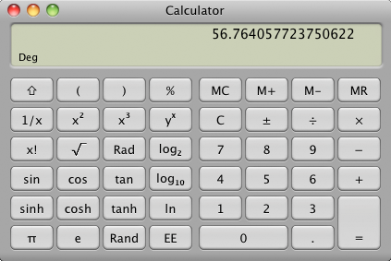
Metaphor
Notes:
You don’t have to explain how to use this. People already know.

Slide 30
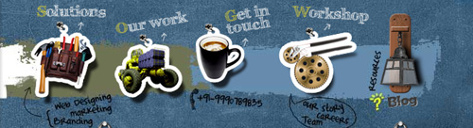
Metaphor
Notes:
Tools = solutions
Tractor = work
Coffee cup = contact, etc.

Slide 31
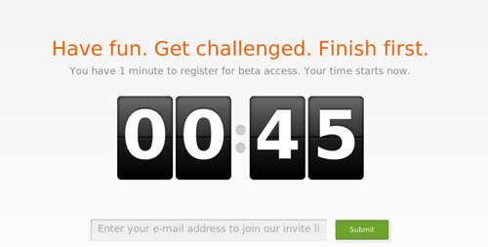
Metaphor
Notes:
The countdown clock.
There is no technical reason to duplicate the “spinning number” behaviour of a physical roll-number timer on a computer screen.
But it means something to people, and by using it, you leverage all that meaning
Other metaphors...

Slide 32
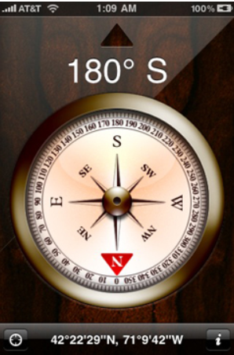
Metaphor
Notes:
Pretty picture. Accesses users’ cognitive model of a physical compass.

Slide 33
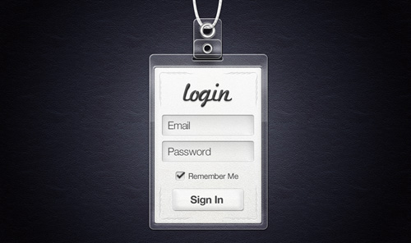
Metaphor
Notes:
The user understands the purpose of having to log in (to identify) without explanation, because of the nametag metaphor

Slide 34

Metaphor
Notes:
Often used to represent “innovation”, “new ideas”
It’s a light bulb. Its connection to innovation is entirely metaphorical.
But it works.

Slide 35
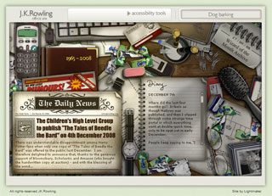
Metaphor
Notes:
Jkrowling.com (old interface – doesn’t look like this anymore)
It’s all metaphor.
In its extreme versions, metaphor can also promote immersion.
This is not a usability feature, and in fact, it can sometimes interfere with usability.
The correct use of metaphor in interface is a topic of some controversy

Slide 36
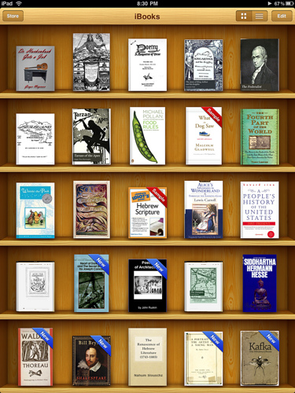
Metaphor
iPad UI Guidelines:
“Whenever possible, add a realistic, physical dimension to your application. The more true to life your application looks and behaves, the easier it is for people to understand how it works and the more they enjoy using it.”
Notes:
Developer.apple.com
But really, is this the best interface for a online book collection? Do you benefit from having it look like a bookshelf? Taking up all that space with those little pictures? For thousands of books?
A caveat
Metaphors should not distract or confuse, they must clarify. Apple and those that design for it love their beautiful interfaces and the metaphors that inspired it, and while attention to detail is highly admired, design abuse via mainstream device iPad, will become rampant. It’s tempting to pull out all the stops, but as with many things in life, exercise restraint.
Sophia Lucero
http://www.wisdump.com/design/beware-the-too-realistic-design-metaphor/

Slide 37
Metaphor
“Metaphors should not distract or confuse, they must clarify. Apple and those that design for it love their beautiful interfaces and the metaphors that inspired it, and while attention to detail is highly admired, design abuse via mainstream device iPad will become rampant. It’s tempting to pull out all the stops, but as with many things in life, exercise restraint.”
Lucero, 2012
Notes:
A caveat
Sophia Lucero
http://www.wisdump.com/design/beware-the-too-realistic-design-metaphor/
Thus, we must avoid metaphor simply for the sake of being clever. Remember the only goal: Empower the user.

Slide 38
Universal Principles 3
Feedback
Sensible designs provide constant feedback about:
What actions have been performed
The resulting changes to the state of the system.
Notes:
When we say “feedback” we often think more about the latter kind, which deals with things like error messages and modal menus and so on. We will talk more about that kind of feedback a bit later.
We concentrate now on the first one, which is important for preventing errors.
Consider, for example, the EFTPOS keypad thingy. Each time a keypress is successfully read by the system, a little beep goes, and an * appears in the display. Imagine using the device without this feedback. You would have no idea when you had pressed the key hard enough. You would perhaps press extra times, sending the wrong digits, and so forth.
Or think about the telephone. Why does the phone take your own voice and route it through the handpiece into your ear? This is how you know how loudly to talk. Think about how people talk when they are wearing headphones – the feedback about their own volume is defective, so they speak very loudly.
For that matter, think about yelling at your kids…..
In computer interfaces we often see the problem of inadequate feedback when operations are slow.
You perform an action -- save a file, open an application, click on a web link -- and nothing seems to be happening.
Is something wrong? Is it just slow?
Does this make you stressed?
Tech support people talk about “fast-clickers”. They’ll click on an object and get no response so they think they didn’t click correctly and they’ll click again and again. If the system was actually just slow, its now got this big buffer of mouse clicks to resolve, often with unanticipated consequences.
An example with Windows is when you try to open a file of an unknown file type.
It takes it a while to build it list of recommended applications, but there is no feedback indicating that this is what is causing the delay.
Keep clicking and you’ll eventually end up with a whole bunch of “Choose Application” windows sprouting all over your desktop.
Or think about the little “ghost file” that follows the mouse when you drag and drop. Without that, you wouldn’t know if you’d correctly “grabbed” the file. (Windows-style interfaces originally didn’t have them, and everyone agreed it was a great improvement when they were added around 1996.)
Or imagine that files icons didn’t highlight when you clicked them. You’d never know what was going on at all.

Slide 39
Universal Principles
When we develop an interface between a person and a device we must strive for:
Visibility
Appropriate affordances
Useful constraints
Natural mappings
Effective feedback
Notes:
These are the things we must strive for when we develop the interface between a person and a device: visibility, appropriate affordances, usefule constraints, natural mappings, and effective feedback. The next time you have trouble with a device – computer or otherwise – see if you can identify which of these basic principles have been violated.

Slide 40
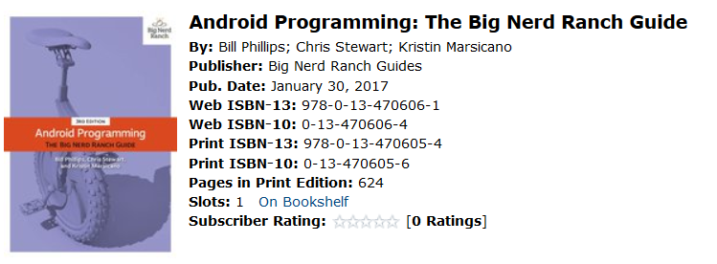
Required Reading
Read and work through chapters 3 and 4 of this book (careful to get the 2015 or 2017 edition):
http://proquestcombo.safaribooksonline.com/
Notes:
These chapters cover the mechanics of the logging tools and debugger for AS.
(The previous version is for Eclipse-ADT. You don’t want that one.)
The example they use is a little app they build in chapters 1 and 2. Feel free to do that first, or just use an app you have lying around.
Access at this URL from any OP machine or, in a browser via the ViewClient from off-campus.
Maybe debugger driver’s license test next session.

Slide 41
Practical
Identify a “non-smart” device that you, or someone you know has had trouble operating.
Briefly describe the device, and the interaction problem.
Indicate which of the Universal Principles are violated in the design of this device.
Propose an alternative design that would ameliorate the difficulty.
Upload, as a Word document, to your repo.
Notes:
Non-smart: not a phone, computer, tablet, etc. Sort-of-smart things like microwaves, DVD players, etc. are ok.
This can probably be done in a single page, but use a much space as needed.
Spelling, punctuation, etc. required.
Images, diagrams, etc. are good for your redesign.

